Slide 1
Student Transcripts Service (STS): Sending Your Marks to Post-Secondary Institutions (PSI)
November 2018

Slide 2
Overview
Online application for students to:
Order and electronically send your transcript to post-secondary institutions. Your transcript is a record of your Gr 10-12 courses with either interim or final marks
Select up to 25 Post-Secondary Institution (PSI) selections for free
Authorize ongoing access for your PSI selections to receive transcript updates throughout the year

Slide 3
Additional Benefits for Students
View your secondary school transcripts
View marks for numeracy assessment and provincial English exam
View scholarships and awards received
Download digital, pdf or hardcopy of official transcripts
Request real time transfer of transcripts to PSI and employers
Receive real time feedback on status of transcript delivery

Slide 4
Getting Started
Important Information for Students
Students must register for a BC Government account, called BCeID, before accessing the StudentTranscript Service.
Students are responsible for ensuring transcript accuracy before sending them to post-secondary institutions. Your counsellor will meet with you later in November to check your transcript accuracy.
Notes:
.

Slide 5
Getting Started: BCeID Sign Up
From the Transcripts and Certificates web page,
select “Sign Up for a BCeID” at this link: BCeID
Find your PEN on the top of your report card!

Slide 6
Getting Started: BCeID Sign Up
Complete the Fields to register for a BCeID

Slide 7
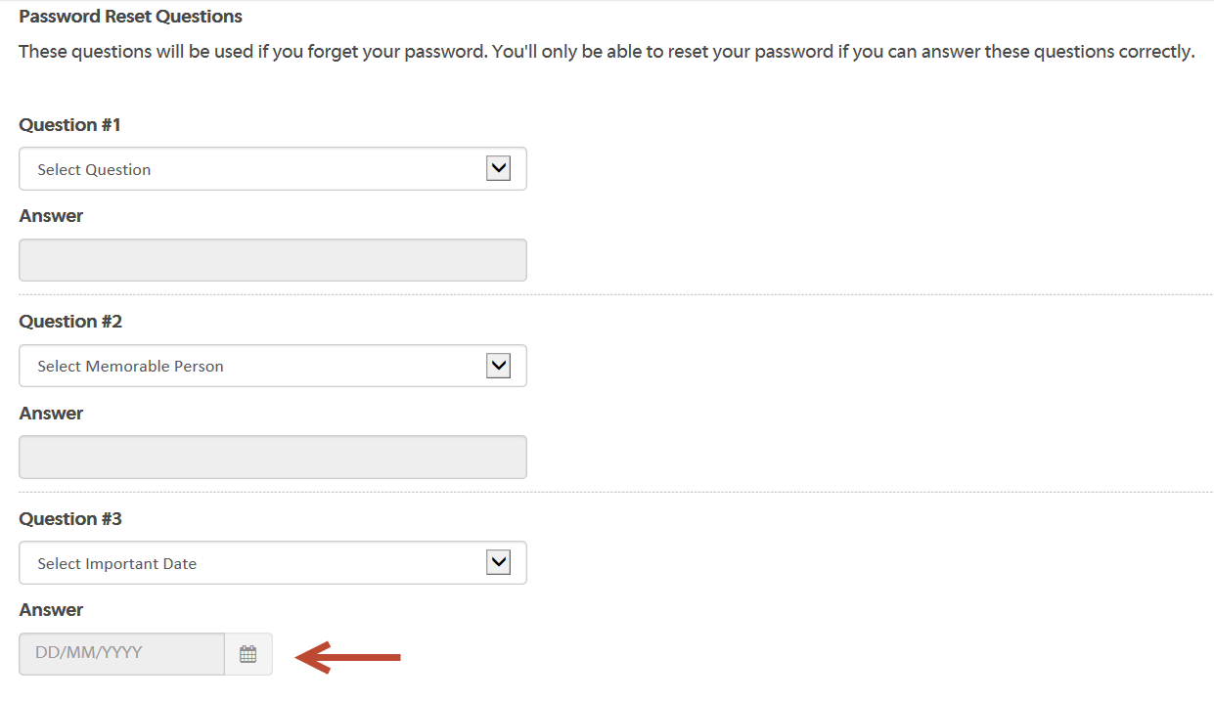
Getting Started: BCeID Sign Up
Select Password Reset Questions and Answers
for your BCeID account
Tip: Select the calendar tool to enter an important date

Slide 8
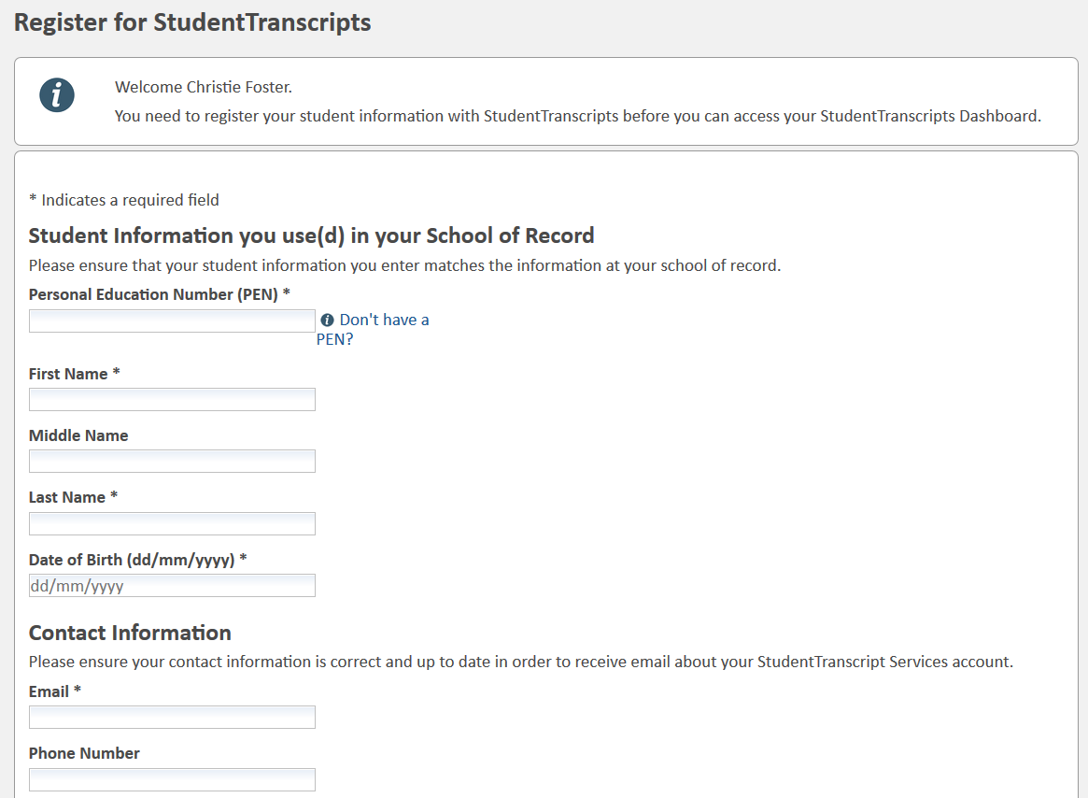
Register for StudentTranscripts
Now you can register for the Student Transcripts Service
on the page that comes up next:
Tip: PEN, legal first name, legal last name, birthdate and email are mandatory fields; must be entered correctly to avoid delays

Slide 9
Authorize Data Collection
Read the Data Collection Notice and click “submit”
to complete the process.

Slide 10
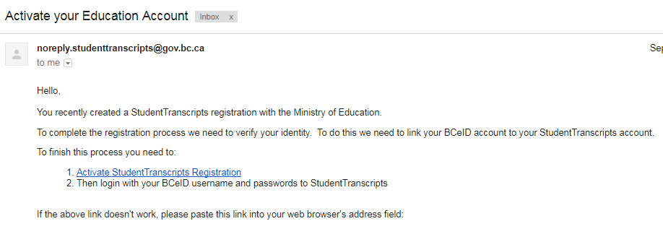
Email Verification
An email confirmation will be sent to activate registration.
Click on link from email verification to link the newly created BCeID to your STS account.
Notes:
.

Slide 11
Logon with the BCeID
Now you can log into the Student Transcript Service at this link:
STS Login

Slide 12
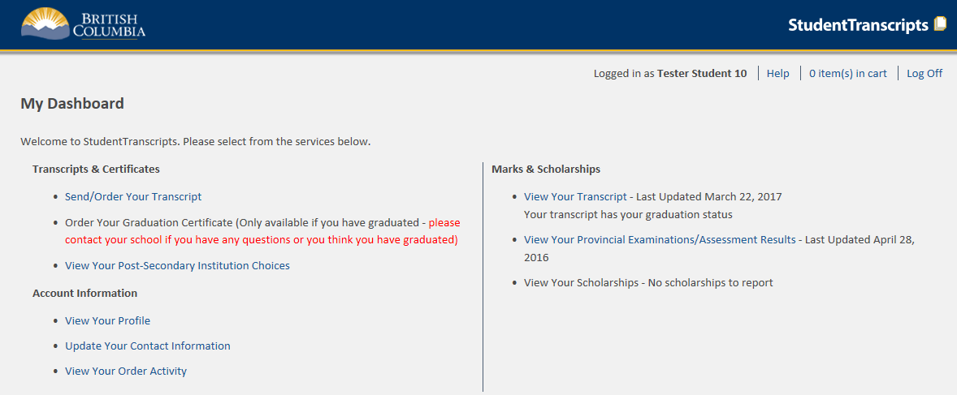
Student Dashboard
Main Student Dashboard with the functions available to you

Slide 13
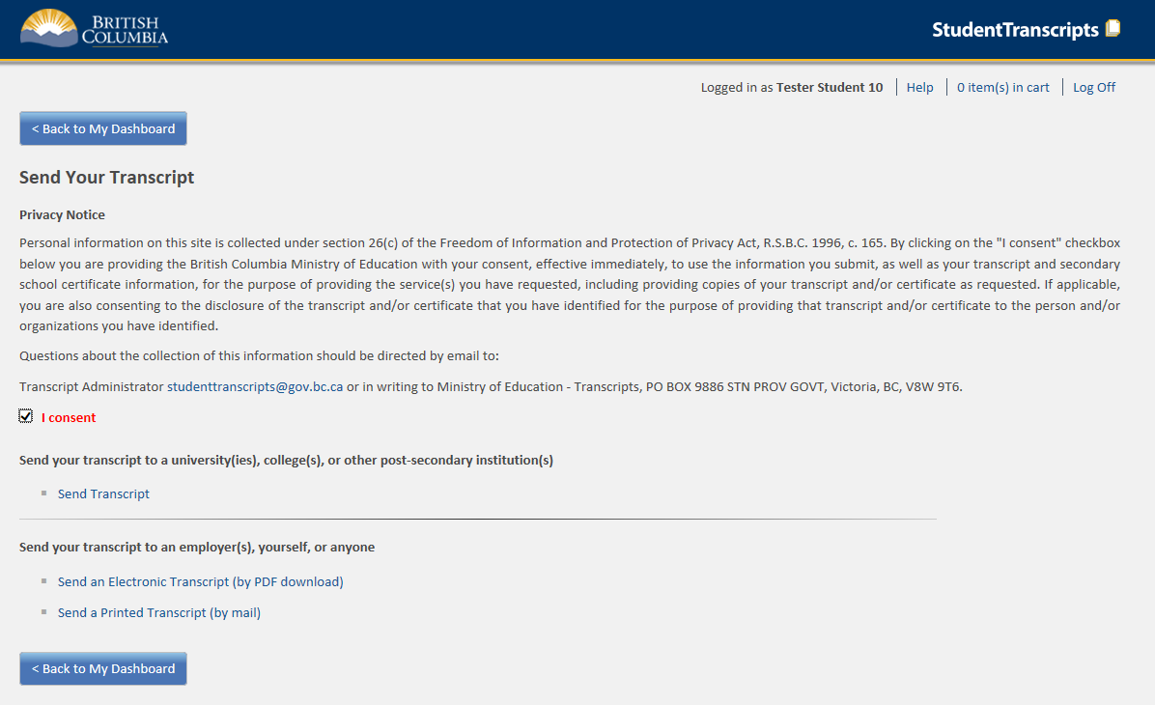
Send/Order your Transcript
Privacy consent activates links below
Choose “Send Transcript to PSI”

Slide 14
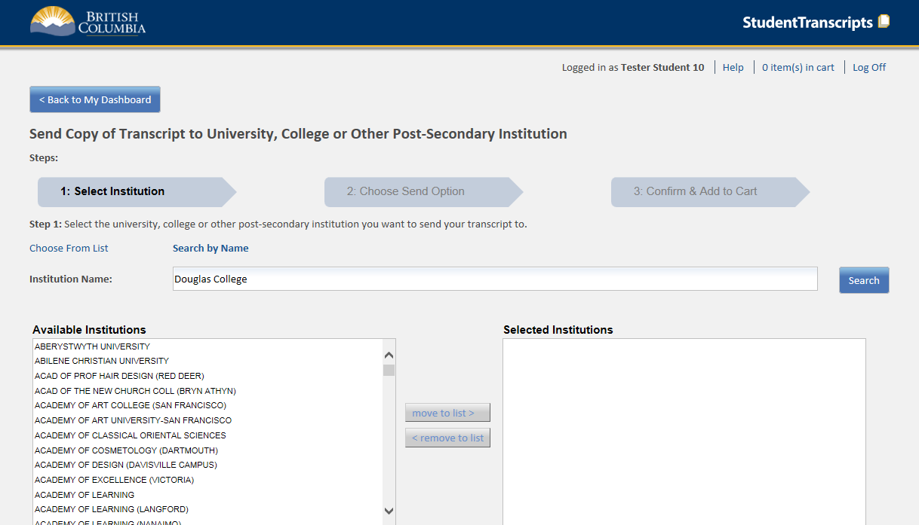
Step 1 – Search for PSI
Select one or more institutions. Choose from the list or search by name. Be sure to click on “move to list” for each selection

Slide 15
Step 2 Choose a Send Option
Choose how to send your transcript to each PSI selected. *Delivery method is dependent on each PSI. Currently the defaults are set to:
• Send my transcript now and allow this PSI to request updates until the date specified below: XML transcript is sent immediately to PSI for downloading and updates can be requested by the PSI until the date selected (defaults to 1 year from the date you do this).
• Send interim and final marks electronically when they are available: interim marks are sent in May and final marks are sent in July.
• Send final marks when they are available: this is displayed when the PSI only receives printed copies of transcripts; your final marks will be mailed in July (contact office for interim copy if you need interim marks sent earlier)

Slide 16
How PSIs Receive Transcripts
The “send options” reflect how the PSIs are currently set up to receive the transcripts.
1. NEW – “XML process” Many PSIs can electronically collect interim transcript data now and then collect updates for interim marks and final marks as they become available throughout the year
2. Some PSIs will electronically take interim transcript data in May after your semester 2 report card marks are available, and then take the final transcript data in July
3. Some PSIs will receive a paper copy of final transcript data from STS in July. If you need to send interim marks earlier, contact the office for an official copy

Slide 17
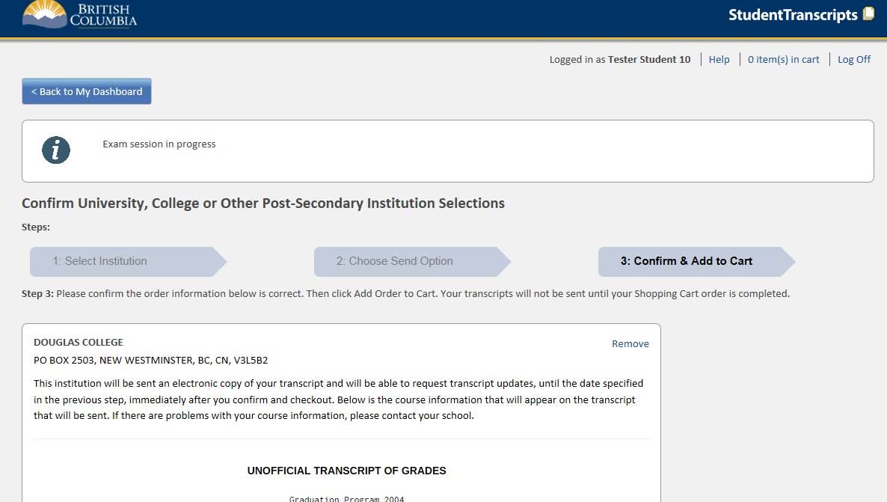
Step 3 – Confirm and add to cart
Message area to alert students if numeracy assessment or English exam is not yet completed
Preview of Transcript prior to sending

Slide 18
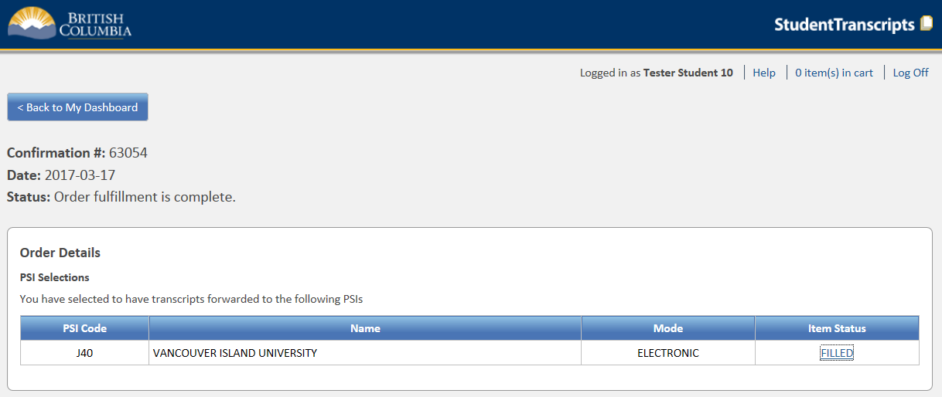
Review Order Details
“Order Details” will list all of the PSIs you had selected
The PSIs that can electronically receive your transcripts now and ongoing (XML) will have a link under Item Status that will initially say “processing” and then “filled” to indicate your transcript order has been done.
If the Item Status says “NEW”, this indicates the PSI does not do XML transfers. Your order is placed and will be filled when interim and final marks become available for transfer.

Slide 19
Need More Help?
For more detailed explanations and answer to your questions about the STS service, visit this link:
STS Help
This power point will be posted on the grad channel of the school app, and on the school website.

Slide 20
School Transcript and Transcript Verification Report
1. Verify that your address is correct.
2. Verify that your name is spelled
correctly.
3. Check for any missing courses that you
have completed (in school, on-line,
summer school, etc.).

Slide 21
4. Ensure that credits have been assigned (usually 4). 5. Check to see that any courses that you have dropped are no longer showing.

Slide 22
School Transcript and Transcript Verification Report 6. at the bottom of the Transcript Verification Report- if it has been marked by a yellow high-lighter-means that you are short courses/credits for graduation. See your counsellor 6. Make corrections on the documents and hand them into the front office by November 30^{th.} 7. If no corrections are needed- keep documents.

Slide 23
8. If there is a yellow high-lighter mark on your Transcript Verification Report: You are not meeting Graduation requirements – see your counsellor. READ INSTRUCTION SHEET

Slide 24
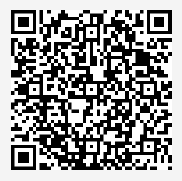
Important Reminder--Numeracy!
ALL grade 12 students must complete the Numeracy Assessment as a graduation requirement. If you did not complete this assessment last year, you must register at this link by November 20 https://tinyurl.com/GleneagleExamReg
If you previously wrote and wish to redo it, you may do so by registering at the link above for our January session.
When you write the Numeracy Assessment, always attempt every question. Any partial mark is better than no mark at all!

Slide 25
Grad Photos
Get your grad photo session booked immediately! On-site photos ends this Friday, Nov 16th. If you do not book into these sessions, you will need to go to Artona in Vancouver to get your grad photos done.
Please visit the link below to book a session or call 604-872-7272
https://artona.com/schools/GEAG/programs/graduation

Slide 26
Post Secondary Tips!
Complete your PSI selections for sending your transcripts by NOVEMBER 30th! You can always go back to it later to add or delete PSIs from your cart as needed
Apply to several PSIs, not just the one place you want the most

Slide 27
More Post Secondary Tips!
Make sure that you are getting all the information needed to apply to the PSI of your choice –it is different for each PSI
If you are very set on a particular program, be sure to apply for that program at several different PSIs AND explore transfer programs e.g. engineering at UBC has a partnership with Capilano University for first year course, UBC has a partnership with Langara College for some other programs, SFU has a partnership with Douglas College and so on…

Slide 28
Final Post Secondary Tips!
If you are doing any online courses, be aware that each PSI has a different completion deadline. For example, SFU requires on-line courses to be completed by Jan 31st
Last tip….Faculty of Arts does not mean visual art classes☺ These are various majors under the Humanities umbrella. Check the details on each PSI website! There are a LOT of choices to explore!

